Slide 1
SECURITY FUNDAMENTALS
Threat - Exploits a vulnerability.
Vulnerability - A system flaw, weakness on the system (on design, implementation etc).
Exploit - Exploits are a way of gaining access to a system through a security flaw and taking advantage of the flaw for their benefit.
Zero-day attack - Attack that occurs before a vendor knows or is able to patch a flaw.

Slide 2
PASSWORD POLICY ELEMENTS
Password complexity requirements. Specifies the composition of the password and its required number of characters. Typically, you would specify the minimum number of characters used in a password, the type of characters allowed, and the required number of numeric characters. For example, many institutions require a minimum of seven or eight characters, one numeral, one special character, as well as a mix of uppercase and lowercase letters.
Password history. Determines the number of unique passwords a user must use before an old password can be reused.

Slide 3
Maximum password age. Determines how long a password can be used before the user is allowed or required to change it.
Minimum password age. Determines how long a new password must be kept before the user can change it.
First Login. Determines if the user will be required to change his password upon first logging in to the system.
Account lockout. Determines the conditions under which an account is disabled for access by the user. For example, if a user fails to properly authenticate after three attempts, then the server can be configured to lock the account on the fourth attempt. The administrator will be required to manually unlock the account for user.

Slide 4
REMOTE ACCESS VS SITE TO SITE VPN
A remote access VPN allows users to securely connect to private networks, even if they are far removed from them. For example, if you work from home or any other remote location, you could use this kind of VPN to access work resources and servers, which might otherwise be reserved for people in your office.
A site-to-site VPN is a VPN that links two networks by routing traffic through designated servers. If a company has two offices, each with its own LAN (local area network), a site-to-site VPN could be used to connect them and allow employees to communicate as if they were all on the same network.

Slide 5
AAA
Authentication
This is a method on the AAA framework wherein the credentials of the user are being challenged by asking, for example, their username and password, which is encrypted using a hashing algorithm that makes it harder for the hackers to intercept.
Authorization
Once the credentials of the user are authenticated, the authorization process determines what that specific user is allowed to do and access within the premise of the network. Users are categorized to know what type of operations they are allowed to perform such as an Administrator or Guest

Slide 6
Accounting
The last process that is done in the AAA mechanism is an accounting of everything the user is doing within the network. AAA servers monitor the resources being used during the network access. Accounting also logs the session statistics and auditing usage information that is being used, usually for authorization control, billing invoice, resource utilization, trend analysis, and planning the data capacity of the business operations.

Slide 7
WIRELESS SECURITY PROTOCOLS
WPA (Wi-Fi Protected Access) is a wireless security protocol released in 2003 to address the growing vulnerabilities of its predecessor, WEP. The WPA Wi-Fi protocol is more secure than WEP, because it uses a 256-bit key for encryption, which is a major upgrade from the 64-bit and 128-bit keys used by the WEP system.
WPA2 (Wi-Fi Protected Access 2) is the second generation of the Wi-Fi Protected Access wireless security protocol. A benefit of the WPA2 system was that it introduced the Advanced Encryption System (AES) to replace the more vulnerable TKIP system used in the original WPA protocol.

Slide 8
WPA3 (Wi-Fi Protected Access 3) is the newest wireless security protocol designed to encrypt data using a frequent and automatic encryption type called Perfect Forward Secrecy. It’s more secure than its predecessor, WPA2, but it hasn’t been widely adopted yet. Not all hardware supports WPA3 automatically, and using this protocol often requires costly upgrades. WPA3 incorporates Simultaneous Authentication of Equals (SAE), a secure key establishment protocol between devices By using a stronger 'handshaking' protocol.

Slide 9
Introduction to Ethical Hacking
CIA
Confidentiality, integrity and availability together are considered the three most important concepts within information security. Considering these three principles together within the framework of the "triad" can help guide the development of security policies for organizations.

Slide 10
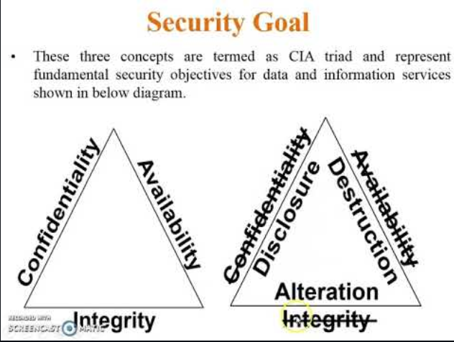

Slide 11
CIA
Confidentiality Keeping systems and data from being accessed, seen, read to anyone who is not authorized to do so. Information is accessible only to the authorized personnel.
Integrity : Protect the data from modification or deletion by unauthorized parties, and ensuring that when authorized people make changes that shouldn't have been made the damage can be undone.
Availability ACCESSIBLE WHEN REQUIRED BY AUTHORIZED USERS: Systems, access channels, and authentication mechanisms must all be working properly for the information they provide and protect to be available when needed.

Slide 12
TYPES OF HACKERS
Black Hat - Hackers that seek to perform malicious activities.
Gray Hat - Hackers that perform good or bad activities but do not have the permission of the organization they are hacking against.
White Hat - Ethical hackers; They use their skills to improve security by exposing vulnerabilities before malicious hackers.

Slide 13
MALWARE
Any software intentionally designed to cause damage to a computer, server or computer network. The code is described as computer viruses, worms, Trojan horses, ransomware, spyware, adware, and scareware, among other terms. Malware has a malicious intent, acting against the interest of the computer user.
Virus - Designed to spread from host to host and has the ability to replicate itself. They cannot reproduce/spread without help. They operate by inserting or attaching itself to a legitimate program or document in order to execute its code.

Slide 14
Worm - self-replicating malware that sends itself to other computers without human intervention
Ransomware - malicious software designed to deny access to a computer until a price is paid; usually spread through email
Trojan horse - A program that is disguised as another legitimate program with the goal of carrying out malicious activities in the background without user's knowledge.

Slide 15
SNIFFING
Sniffing is the process of monitoring and capturing all the packets passing through a given network using sniffing tools. It is a form of “tapping phone wires” and get to know about the conversation. It is also called wiretapping applied to the computer networks.

Slide 16
SOCIAL ENGINEERING
Social Engineering is the art of manipulating a person or group into providing information or a service they would otherwise not have given.
Research target company
Visit websites, tour the company, etc
Select the victim
Identify frustrated employee or other target
Build a relationship
Develop relationship with target employee
Exploit the relationship
Collect sensitive information and current technologies

Slide 17
Human nature/Trust - trusting others
Fear of consequences of not providing the information
Greed - promised gain for providing requested information
Dumpster Diving - Looking for sensitive information in the trash
Impersonation - Pretending to be someone you're not
Shoulder Surfing - Looking over someone's shoulder to get info

Slide 18
DENIAL OF SERVICE
A Denial of Service (DoS) is a type of attack on a service that disrupts its normal function and prevents other users from accessing it. The most common target for a DoS attack is an online service such as a website, though attacks can also be launched against networks, machines or even a single program.
A distributed denial of service (DDoS) attack is launched from numerous compromised devices, often distributed globally in what is referred to as a botnet.

Slide 19
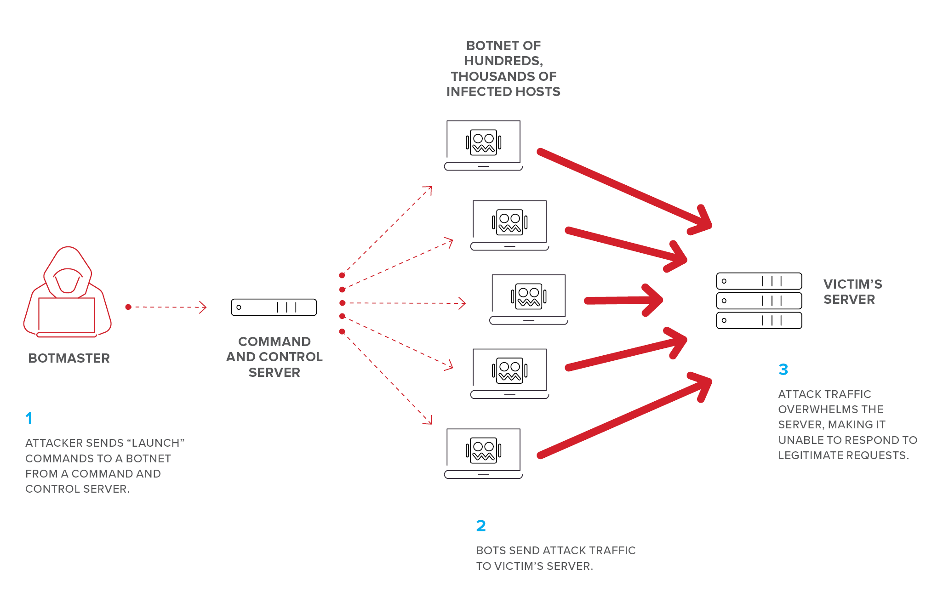

Slide 20
SESSION HIJACKING
The Session Hijacking attack consists of the exploitation of the web session control mechanism, which is normally managed for a session token.
The Session Hijacking attack compromises the session token by stealing or predicting a valid session token to gain unauthorized access to the Web Server.

Slide 21
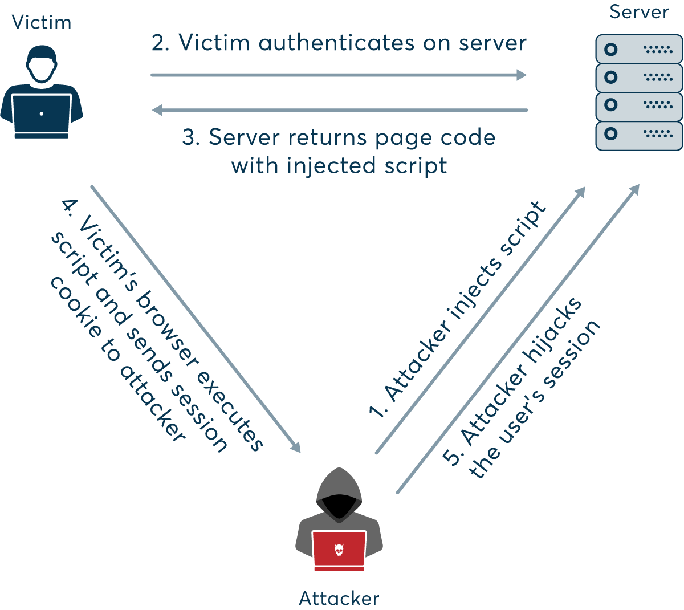

Slide 22
HACKING WEB SERVERS
5 Phases of Hacking
Recon
Scanning and Enumeration
Gaining Access
Maintaining Access
Covering Tracks

Slide 23
HACKING WIRELESS NETWORKS
Rogue Access Point - Unauthorized access point plugged into a wired one. (Can be accidental)
Evil Twin - Is a Rogue AP that is broadcasting the same (or very similar) SSID.
Also known as a mis-association attack
Honeyspot - faking a well-known hotspot with a rogue AP
Ad Hoc Connection Attack - connecting directly to another phone via ad-hoc network
Not very successful as the other user has to accept connection
DoS Attack - either sends de-auth packets to the AP or jam the wireless signal
With a de-auth, you can have the users connect to your AP instead if it has the same name
Jammers are very dangerous as they are illegal
MAC Filter - only allows certain MAC addresses on a network

Slide 24
HONEYPOTS
Honeypots are decoy systems or servers deployed alongside production systems within your network. When deployed as enticing targets for attackers, honeypots can add security monitoring opportunities for blue teams and misdirect the adversary from their true target.
Honeynet - Two or more honeypots on a network form a honeynet. Honeynets and honeypots are usually implemented as parts of larger Network Intrusion Detection Systems.
A Honeyfarm is a centralized collection of honeypots and analysis tools.

Slide 25
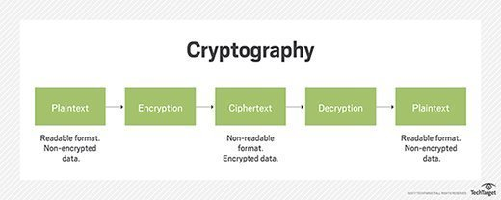
Cryptography

Slide 26
Cryptography
Cryptography
Science or study of protecting information whether in transit or at rest
Renders the information unusable to anyone who can't decrypt it
Takes plain text, applies cryptographic method, turn it into cipher text

Slide 27
Cryptography
Symmetric Encryption - One Single Key / Session Key to encryption and decryption.
Known as:
Single key cryptography
Secret key cryptography
Shared key cryptography
Session key cryptography

Slide 28
Cryptography
Asymmetric Encryption
Uses a Key pair:
Public Key - Anyone can see this key; give it away
Private Key - Keep this private; used for decryption; The private key is used to digitally sign a message.

Slide 29
Cryptography
Hashes
One-way encryption
Verify the Integrity of the message.
Verify the authenticity of the message (proof of origin & non-repudiation)
Impossible to recover the original message from the digest
Used to store passwords providing confidentiality.

